Slide 1
On Sufficient and Necessary Conditions in Bounded CTL: A Forgetting Approach
Renyan Feng^{1,2}
Authors: Erman Acar², Stefan Schlobach², Yisong Wang¹, Wanwei Liu³
¹Guizhou University, P. R. China
²Vrije Universiteit Amsterdam, The Netherlands
³National University of Defense Technology, P. R. China

Slide 2
Overview
Motivation
CTL
CTL
V-bisimilarity
Forgetting
Definition
Properties
Complexity Results
SNC and WSC
Contributions and Thanks

Slide 3
Motivation
WP/SP: The Weakest precondition (WP) and the Strongest Post-condition (SP), thanks to Edgar Dijkstra, have been fruitfully used for specification and verification of concurrent/ distributed systems [1].
Forgetting:
It is an important method to compute the Weakest Sufficient Condition (WSC) and the Strongest Necessary Condition (SNC) in Propositional Logic (PL) and First-Order Logic (FOL) [2], and
It is a technique to distill knowledge from a theory [3].

Slide 4
Motivation
Two important logical notions (SNC and WSC) [2]:
The Strongest Necessary Condition (SNC) is the most general consequence；and
The Weakest Sufficient Condition (WSC) is the most specific abduction
Note:
The SNC and the WSC correspond to the Weakest precondition (WP) and the Strongest post-condition (SP) respectively.
WP was wildly used in verification (generate counterexample, refinement).
How can we get such WP in CTL under the reactive system?

Slide 5
CTL
: transition relation : label function
S: a finite set of states
s₀: an initial state in S
Stands for Computation Tree Logic
Informally, CTL is interpreted over Kripke Structures
Let M = ( S, R, L, s₀) be an initial structure
initial sate: a state with each state in S can be arrived from it.
We call (M,t) a K-structure (t∈S), and if t is an initial state, then (M,t) is an initial K-structure.
The path quantifiers: A and E
The temporal operators: X (neXt), F (Future), G (all future states (Globally)), U (Until)
is a Kripke structure (S,R,L) with initial state s₀

Slide 6
CTL - Syntax and Semantics
ϕ ::= p // atomic (state) proposition: | ¬ϕ | ϕ₁ ∧ ϕ₂ | EX ϕ | EG ϕ | E(ϕ₁ U ϕ₂)
(M,t) ⊨ ϕ ϕ holds on the sate t
Which is recursively defined as follows:
(M,t) ⊨ p iff p ∈ L(t)
(M,t) ⊨ ¬ϕ iff not ( (M,t) ⊨ ϕ )
(M,t) ⊨ ϕ∧ψ iff (M,t) ⊨ ϕ and (M,t) ⊨ ψ

Slide 7
CTL
(M,t) ⊨ EXϕ iff ( ∃(t,v)∈ R such that (M,v) ⊨ ϕ )
(M,t) ⊨ EGϕ iff
There is a path σ=(t₀=t, t₁,...) in M, starting at t such that:
For all i≥0, (M, t_{i})⊨ ϕ
(M,t) ⊨ E[ ψ U ϕ ] iff There is a path σ=(t₀=t, t₁,...) in M, starting at t such that:
For some i≥0, (M, t_{i} )⊨ ϕ
For all previous j, 0≤j<i, (M, t_{j} )⊨ ψ

Slide 8
Bounded CTL
The size of CTL formula is bounded to n.
It will be sufficient to consider the models of formulas within a state space S satisfying [4].
Why?
Most of the systems that can be dealed with the computer are finite and also the CTL formula.

Slide 9
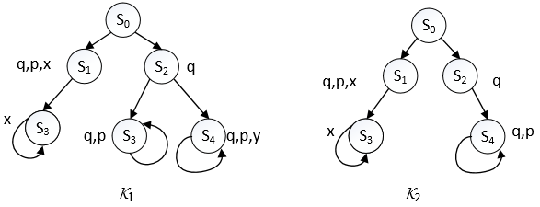

V-bisimilarity
Two V-bisimilar initial K-structures, V={y}.
P={p,q,x,y}
V-bisimilar
S₅

Slide 10
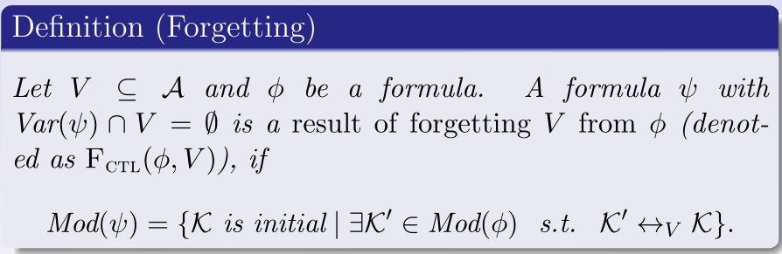
Definition - Forgetting
: the set of atoms appearing in .
: the set of models of .
Such a formula always exists in Bounded CTL.

Slide 11
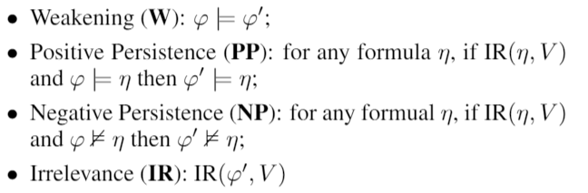
Important postulates in Forgetting
The following four postulates are proposed by Zhang at al. [5]
IR( ,V) means that there exists a CTL formula such that and do not contain any atoms in V.

Slide 12
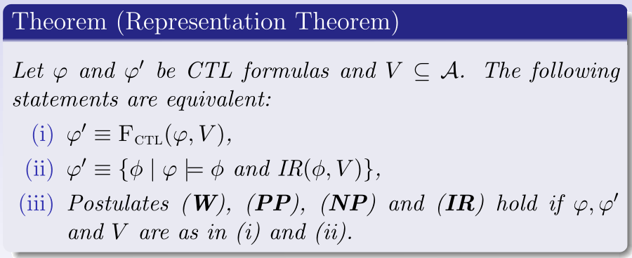
Properties - Representation Theorem

Slide 13
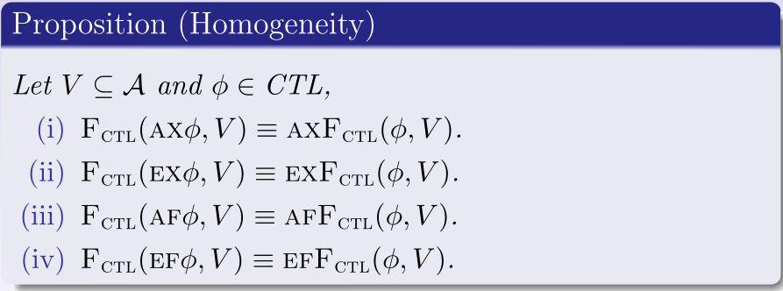
Properties - Homogeneity

Slide 14
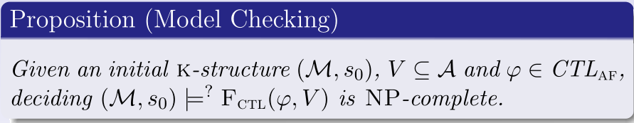
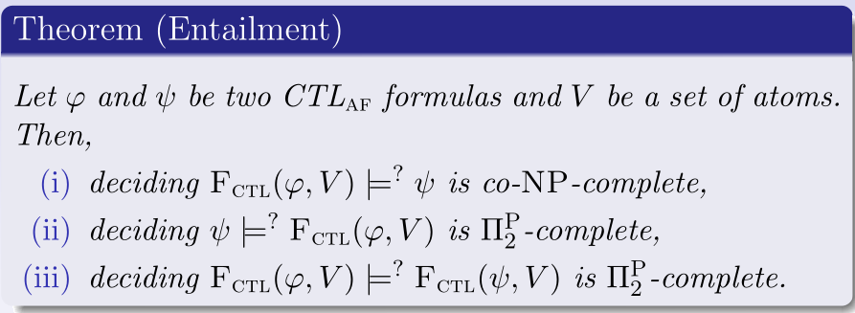
Complexity Results

Slide 15
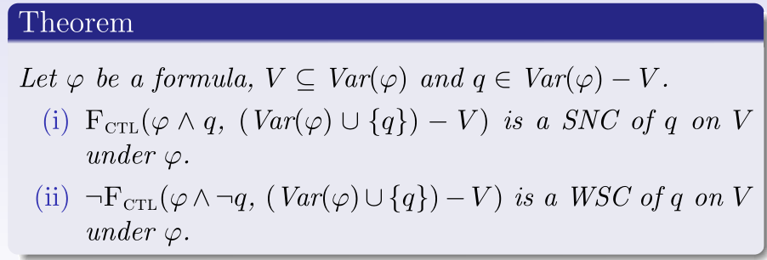
SNC and WSC
Dual
SNC
WSC

Slide 16
Contributions
A Forgetting framework for CTL
Representation Theorem
Complexity results
Algebraic Properties of the Forgetting operator: Homogeneity, Commutativity, and others
Computing SNC and WSC by using Forgetting in CTL

Slide 17
Reference
[1] Dijkstra, E. W. 1975. Guarded commands, Nondetermi-nacy and Formal Derivation of Programs.Commun. ACM18(8):453–457.
[2] Fangzhen Lin. On the strongest necessary and weakest sufficient conditions. Artificial Intelligence 128 (2001) 143-159.
[3] Lin, F., and Reiter, R. 1994. Forget it. In Working Notes of AAAI Fall Symposium on Relevance, 154–159.
[4] Emerson, E. A., and Halpern, J. Y. 1985. Decision proce-dures and expressiveness in the temporal logic of branchingtime.Journal of computer and system sciences30(1):1–24.
[5] Yan Zhang and Yi Zhou. Knowledge forgetting: Properties and applications. Artificial Intelligence, 173(16-17):1525–1537, 2009.

Slide 18
Thank you for your attention!

